Slide 1
Brute Force

Slide 2
Overview
Selection Sort
Bubble Sort
Sequential Search
Brute Force String Matching

Slide 3
Brute Force
It is a straightforward approach to solve a problem, usually directly based on the problem statement and definitions of the concepts involved.
It is applicable to a very wide variety of problems.
For some important problems (eg. Sorting, searching, matrix multiplication, string matching) the brute force approach yields reasonable algorithms of at least some practical value with no limitation on instance size.
The expense of designing a more efficient algorithm may be unjustifiable if only few instances of a problem need to be solved. Brute force can solve this with acceptable speed.
Even if too inefficient in general, a brute force algorithm can still be useful for solving small size-instances of a problem.

Slide 4
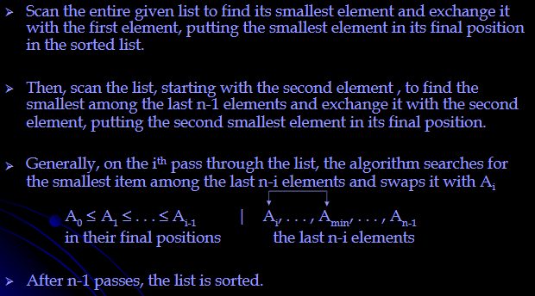
Selection Sort

Slide 5
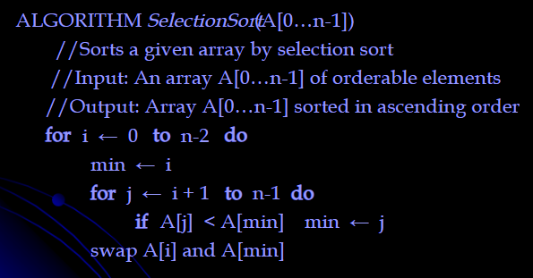
Selection Sort - Algorithm

Slide 6
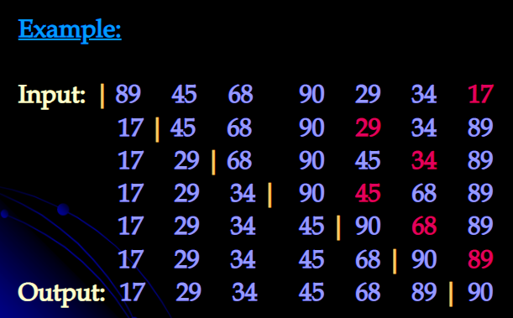
Selection sort - Example

Slide 7
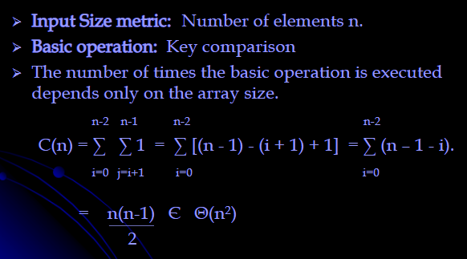
Selection Sort - Analysis

Slide 8
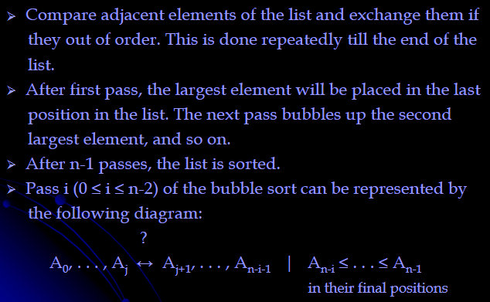
Bubble Sort

Slide 9
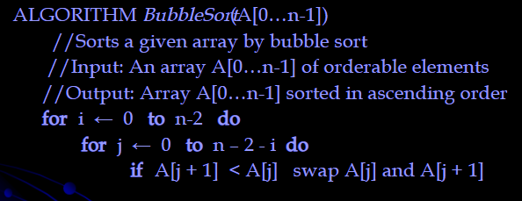
Bubble Sort - Algorithm

Slide 10
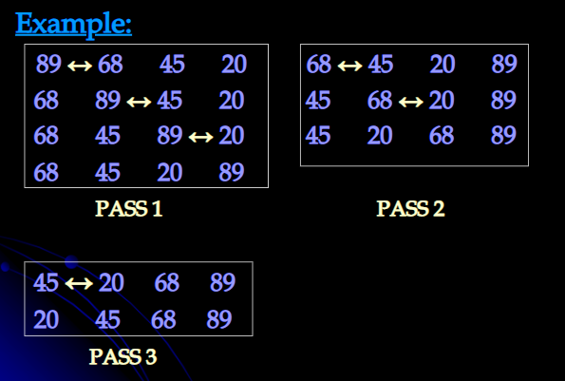
Bubble sort - Example

Slide 11
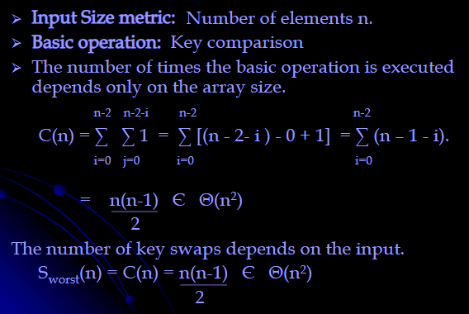
Bubble sort - Analysis

Slide 12
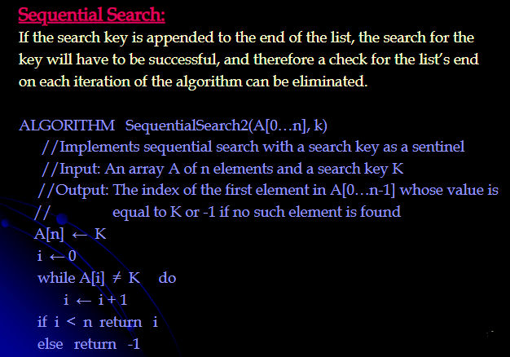
Sequential Search

Slide 13
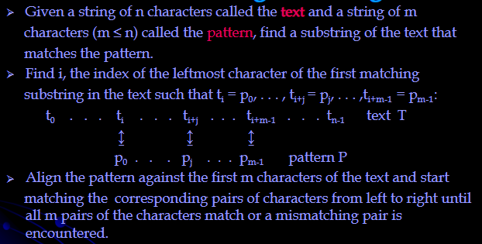
String Matching – Brute Force

Slide 14
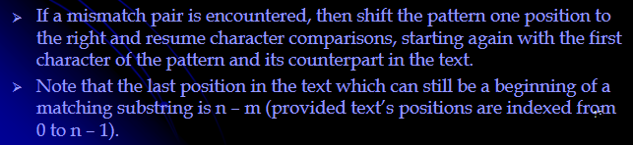
String Matching – Brute Force

Slide 15
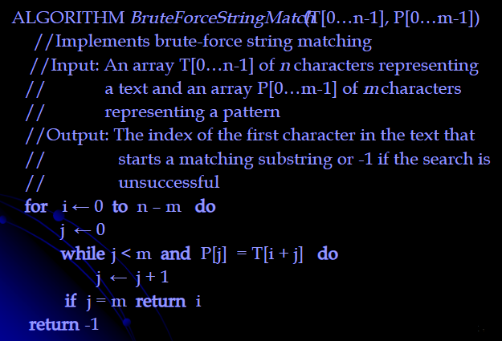
String Matching - Algorithm

Slide 16
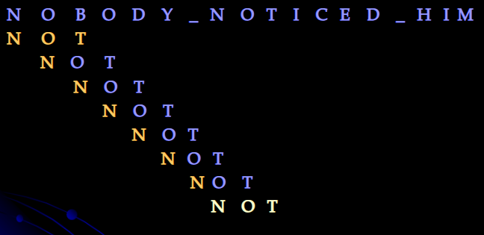
String Matching - Example

Slide 17
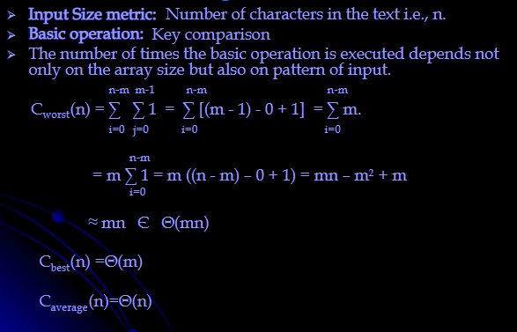
String Matching - Analysis

Slide 18
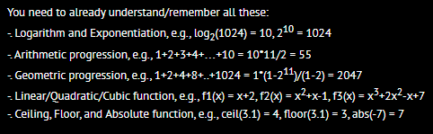
https://visualgo.net/bn/sorting?slide=6-3
https://www.hackerearth.com/practice/algorithms/sorting/selection-sort/visualize/

